Slide 1
Examining Distributed Ledger Technologies for V2X Communication A Road Condition Monitoring Application using the IOTA Framework
James O’Connor

Slide 2
Presentation Summary
Introduction
Vehicle-to-Everything (V2X) Communication
Distributed Ledger Technology (DLT)
The IOTA Framework
Research Objectives, Scope & Plan
Notes:
A quick summary of the presentation, it is broken into 5 sections.
We will start with a quick introduction into the research. The next three sections, we will break apart the different technologies that are involved in this exploratory research.
I will start with giving an overview of V2X communications and some clnclusions drawn from the literature review
An overview of Distributed ledger technologies
The IOTA Framework (which is the distributed ledger technology I am exploring)
And then Section 5 will cover the research objectives, scope and plan for the next few months

Slide 3
1. Introduction

Slide 4
The goal of this research is to explore the potential of DLTs in the autonomous vehicle (AV) industry.
This will be explored through the development of an application for vehicle-to-everything (V2X) communication.
The two key areas of focus are are security and scalability.
Research Hypothesis:
”The IOTA DLT framework can be used as a secure and scalable V2X communication protocol for OBU data transmission among autonomous vehicles to share data and identify dangerous road conditions.”
Notes:
So to reiterate, I am exploring the potential of DLTs in the autonomous vehicle (AV) industry
And this will be done through the development of a V2X communication application.
…and the research focus here will be on security and scalability – by that I mean data and device security and application/ platform scalability
Good to begin with the hypothesis and we can work back from there. The research hypothesis is as follows:
Lot to unpack here, so the next few sections will discuss the components of this hypothesis in detail

Slide 5
2. V2X Communication
Notes:
The first concept I’m going to discuss is V2X communication

Slide 6
Wireless technology that enables data exchange between vehicles and their surroundings.
V2X – encapsulating term for vehicle-to-vehicle (V2V), vehicle-to-infrastructure (V2I) and vehicle-to-pedestrian (V2P) communication.
5.9 GHz frequency dedicated for intelligent transport systems.
Two V2X standards:
DSRC (1999) & ITS-G5 (2010) – US & EU standards based on IEEE 802.11p physical layer standards
Cellular-V2X (2016) - Third Generation Partnership Project (3GPP)
No clear winner as of yet
Notes:
What Is it? Essentially, it is the wireless..
It is also an encapsulating term for…
It operates at..

Slide 7
Types of V2X Communication
Safety-Critical Characteristics | Non-Safety-Critical Characteristics
WAVE¹ low latency communication (End to end latency should be <100 ms) Basic Safety Messages (BSM) are broadcast from DSRC radio every 100ms Example applications: Forward Collision Warning (FCW), Lane Change Warnings (LCW), Blind Spot Detection (BSD) High availability (Should not compete with other crowded communications networks such as WiFi and cellular networks) | Cellular-based communication User Datagram Protocol (UDP) and Internet Protocol Version 6 (IPv6) (>100ms) Examples applications: infotainment applications, media sharing Less redundancy required
1. Wireless Access in Vehicular Environments
Notes:
What I want to do is to define two types of V2X – mostly because this research refers to one type of V2X communication and not the other.
There are safety-critical applications and non-safety critical applications.
Safety-critical applications use low latency communications to transmit basic safety messages between vehicles and road side units using radio transmitters and receivers - this happens in under 100 ms
Examples of these apps are 1) 2) 3)
They need to have high availability and redundancy
Then there are non-safety-critical applications which use cellular technology and protocols like UDP and Internet protocols
Examples of these apps are 1) 2)

Slide 8
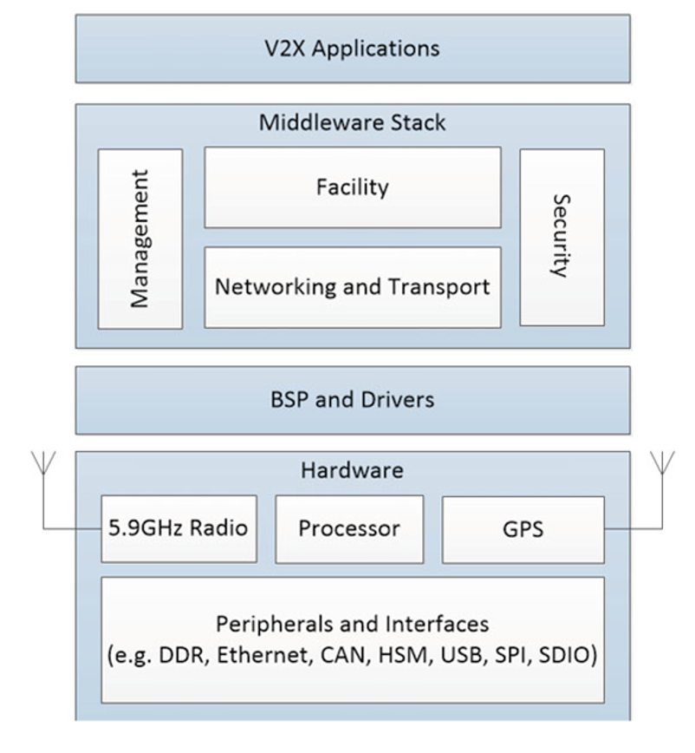
The On-Board Unit (OBU)
V2X Application layer
Upper layer standards to provide message encoding and decoding, signing and verifying BSMs, network and transport services Provides data from received V2V message to the application layer in a way that can be understood by an application developer using APIs
Software for hardware specific operations required to get the OS up and running Provide support for the hardware components and a way for the Middleware Stack to access them
Transmission and reception of V2V messages Peripherals Interfaces for supporting the vehicle modules Hardware Security
[1]
[1] R. Miucic, Connected Vehicles: Intelligent Transport Systems. Detroit: Springer, 2019.
Notes:
The OBU is the device that is mounted on vehicles that allows them to communicate. It’s kind of like an expensive internet router
This is what the OBU stack looks like for a DSRC based system
4 layers
1 - hardware
2 - boots os and provides support for the hardware to the middleware
BSP = Board Support Package
3 - handles the networking, transport, message encoding and deciding, APIs that developers can use to make devloping v2v apps easier
4 - And then on top of this sits the application layer

Slide 9
Lot of research currently in this area in C-V2X, DSRC, ITS-G5, credential management
Advent of 5G communication enabling low-latency cellular communication
Competing standards in the industry
Keeping these devices safe remains a challenge – Public Key Infrastructure (PKI) is convoluted and inefficient - hardware security certifications can take months to revoke
30% of V2X applications will be non-safety related by 2027¹
This research will explore new ways that vehicles can communicate for non-safety-critical V2X applications, securely, ubiquitously and at scale.
1. ABI Research: https://www.abiresearch.com/press/by-2027-30-of-v2x-applications-will-be-non-safety-/
Notes:
As of today, approximately 10% of apps are classified as non-safety apps, but this is expected to grow to 30% in the next six years
And this is really where this research sits

Slide 10
3. Distributed Ledger Technology (DLT)
Notes:
This is where Distributed Ledger Technologies comes in

Slide 11
Definitions
A system of electronic records that enables a distributed network of participants (nodes) to reach a consensus on the authoritative order of transactions, which are linked using cryptographic hashes and persisted across all nodes of the network.
DLT is a consensus machine; a system with multiple actors who agree on a set of shared data and its validity, in the absence of a centralized co-ordinator {link}
”A paradigm shift in application development, moving away from centralised hub-and-spoke architecture. Core principles rooted in consensus and cryptography promoting security, integrity, and transparency of data and applications.”
Notes:
So what is it? In order to understand the IOTA framework is, we have to first discuss DLTs. There are many ways that distributed ledger technology can be defined as
1
2
3

Slide 12
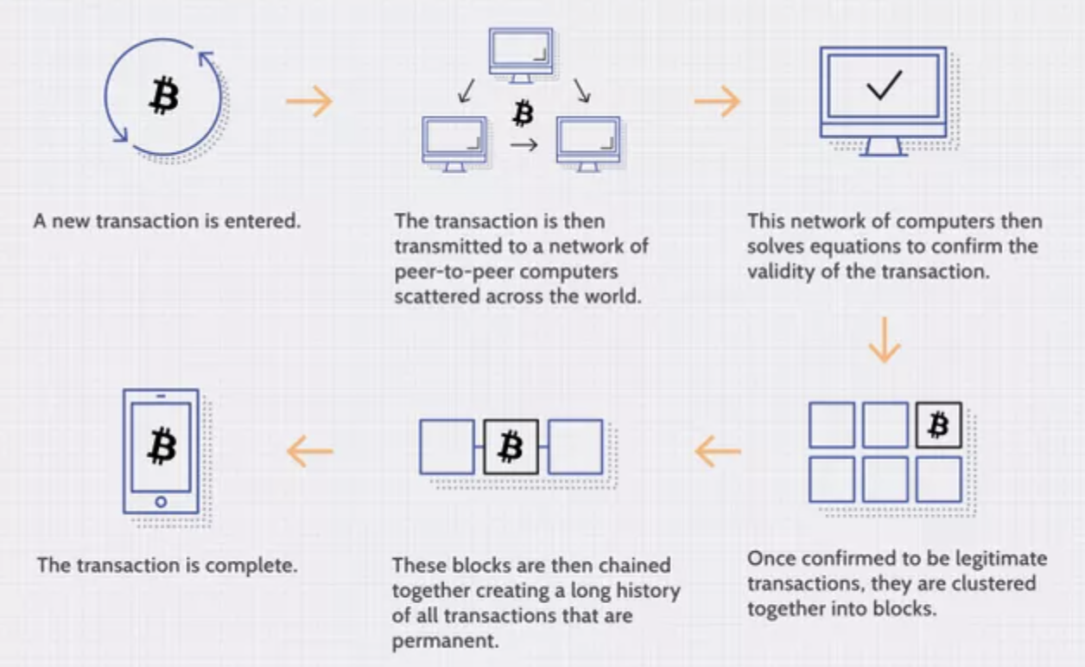
A DLT Example: Blockchain
3 Main Components:
Nodes
A Shared Ledger
Transactions
link
Notes:
To go a little deeper, I will quickly talk through an example of a DLT
Blockchain is the most popular form of DLT used in the industry today.
Three main components to any DLT :
Nodes – network of computers organised in a peer-to-peer architecture, that provide the network computing power.
Ledger – An authoritative order of valid transactions stored and shared on all nodes
Transactions – Data or value transfer between two parties
I’m going to walk through how a typical blockchain works. This is the bitcoin protocol, which is the most popular DLT built in 2008 using blockchain technology and really brought DLTs to centre stage.
Here is a high level of how the network operates
1) Transactions, signed with a public key, get sent to all of the nodes for approval
2) Network of computers solve an equation to confirm validity
3) Once the puzzle is solved, these transactions are added to the cryptographically chained link of logical units called blocks and the transaction is complete

Slide 13
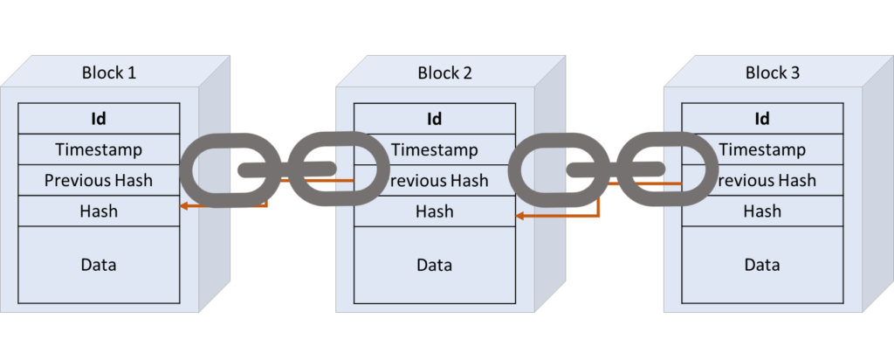

A DLT Example: Blockchain (2)
SHA-256 Examples – 64 Digit Output
f("Hello World”) = 07cf55095ef805a89c07bf3d4764b07352a8f4b2cc3df166e89d2193131536bd
f("Hello_World”) = faaeb9f485c750ca9275930a4f3f9999b712d8f347284352e8aabbf019ff2ba5
[1]
static inputs
variable input
$$1.5∗{10}^{−22 }\%$$
$$f\left(transactions, timestamp, previous_hash,block_id, nonce\right)=hash$$
1. Link: https://www.paiementor.com/blockchain-explained-application-payments/
Notes:
In my opinion, the best way to start understanding how blockchain works is to understand what a hash function is.
A hash function is a function that takes a number of inputs produces an output of fixed length. So for example, the SHA256 hash function takes an arbitrary set of input data and maps it to a unique 64 digit signature output.
click twice
The bitcoin network uses this exact hash function to validate blocks of transactions. In order to add a block of about 500 valid transactions to the shared ledger, nodes have to first solve a puzzle, by essentially guessing a valid SHA256 hash function output. This is also known as “mining”.
The static input values to this hash function are the block number, the block id, the hash value from the previous block, valid signed transactions to be confirmed, (about 500) and a timestamp. There is only one input value that is variable and this is called a nonce.
With all the other input values static, the nodes loop through different nonce values until it outputs a valid hash value.
These valid hash values are set by the bitcoin source code, they change periodically, and at any given time there are very few of them. There’s about a 1.5*10-22 chance of calculating this, or about ten minutes for a computer.
Once the block cracks the code, it gets to add the block to the ledger, and gets rewarded, typically in cryptocurrency.
What we end up with is a chain of transaction data, called a ledger, broken into logical units, all dependently linked using hash values. This makes the data immutable because you can’t change the data.
If you changed it you would produce a different hash value. Because they’re all linked, If any hash value changed along the chain, this would invalidate the entire chain of blocks. It’s like trying to unbake a cake. The network operates on a “longest-chain-wins” system so only way to out-run the chain is if you had the majority of computational power in the network.
So that’s how a typical blockchain works. There are many different kinds with their own nuances but this is a popular approach.
With this approach we get data transparency, data immutability and security. Sounds great, so what’s the catch? blockchains are not a silver-bullet solution.– It has a slow throughput and can have a huge environmental impact, and high transaction fees. To use our same example, the bitcoin network can only confirm 500 transactions every ten minutes and uses about 0.5% of the global energy consumption to run the network and cost more based on the network congestion.

Slide 14
4. The IOTA Framework
Notes:
I fundamentally believe in DLT, but the current blockchain format does not scale well and consumes a vast amount of energy.
If you can imagine, if the bitcoin protocol only confirms 500 transactions per 10 minutes, then the use cases in terms of connected devices is limited.
What if we could get the benefits of DLT, with a higher throughput of feeles transactions using less computational energy?
This is where the IOTA framework comes in

Slide 15
Created in 2017 by the IOTA Foundation and built specifically for the IoT eco-system
Shared Ledger
“The Tangle” – IOTA ledger data structure based on a Directed Acyclic Graph (DAG), instead of a chain of blocks
Nodes
Store the ledger and relays updates to other nodes using a gossip protocol
Enable read write access to Tangle
Validate transactions through Proof-of-Work (approx. 0.4s per transaction)
Transaction
32KiB message object
Data or value transfer (using MIOTA network token)
Signed with private key and must include reference to between 2-8 confirmed parent message IDs on the tangle
Notes:
The IOTA framework is a DLT that was created in 2017 by the IOTA Foundation specifically for IoT devices to deal with these two issues. They are aiming to build a framework that enables fast micro-transactions in a m-2-m economy.
So again, IOTA is a DLT, that means we have a shared ledger, we have nodes and transactions.
The biggest difference between IOTA DLT and other blockchains is that it does not use blocks or mining. Instead, the IOTA foundation created what they called the tangle, which is data structure that they use for the shared ledger
This makes the network feeless (as there is nobody to pay), it speeds up the transaction confirmation process and reduces the computational power required.
Again like our blockchain example, the network nodes (computers) store and share the ledger, enable read/write access to the ledger and validate transactions
The transactions are in the form of

Slide 16
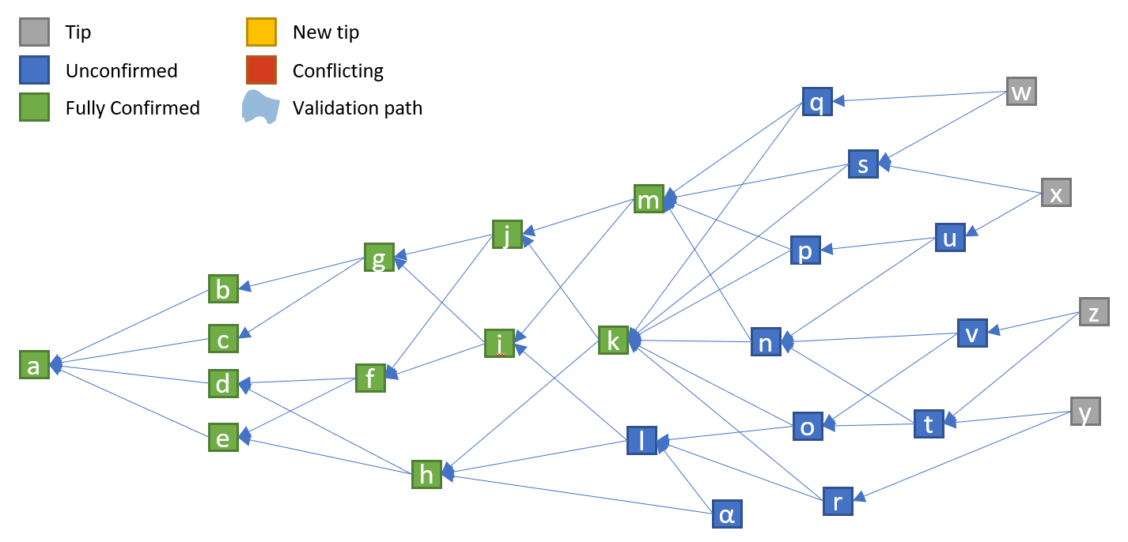
[1]
The Tangle Visualiser
[1] Nonymous. "Blockchain-Based Peer-to-Peer Energy Trading and Charging Payment System for Electric Vehicles." https://github.com/noneymous/iota-consensus-presentation

Slide 17
IOTA Products
1) IOTA Streams | 2) IOTA Identity
Encrypted communication channel Consists of two actors - Authors (Channel owners) and Subscribers Used to cryptographically sign and transmit data securely to the tangle between trusted parties. Authors have full control over channel subscribers, they can check message authenticity and can revoke access at any time | Allows for the creation of an immutable digital identity document for devices when a new device gets created A “digital twin” is created and stored in the IOTA Tangle, giving the device an immutable digital identity Signed transactions from devices can be verified against the digital identity document stored on the Tangle, ensuring that they have come from a secure device

Slide 18
6. Research Objectives, Scope and Plan
Notes:
So how does this all pertain to my research?

Slide 19
Research Scope
Model and simulate a scenario of a fleet of vehicles on a dangerous road (in Python).
Develop an application using the IOTA client libraries that vehicles can use to transmit OBU data (traction control warnings).
Application components:
IOTA Streams will be used to create an encrypted communication channel
IOTA Identity will be used to create the device digital identity
IOTA Tangle will be used as a transport layer for transmitting OBU data and the storage of the device digital identity
Data from the Tangle will be collected by the encrypted channel Author, verify that the data is from a registered device and analyse it to find anomalies in locations where traction control is activated. This should allow us to detect adversarial road conditions.

Slide 20
Objectives
Identify the benefits and limitations of the IOTA Framework
Compare DLT to the current state-of-the-art to traditional architectures.
Quantify the ease of developing decentralized applications using IOTA framework
Propose an approach to deploying IOTA applications for autonomous vehicles.
Highlight future applications and areas for future research.

Slide 21
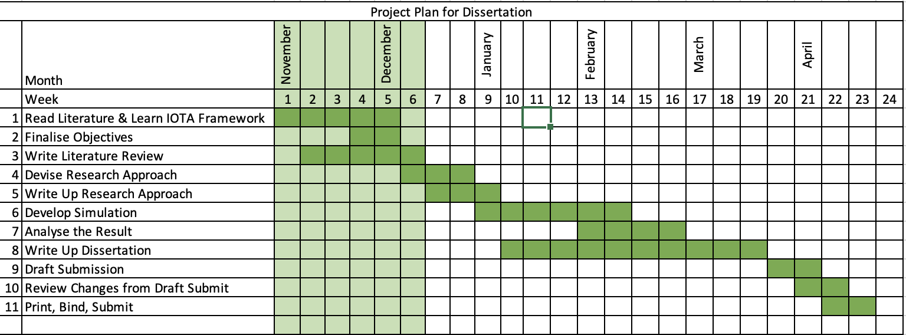
Research Plan

Slide 22
Thank You

